Slide 1
Variance

Slide 2
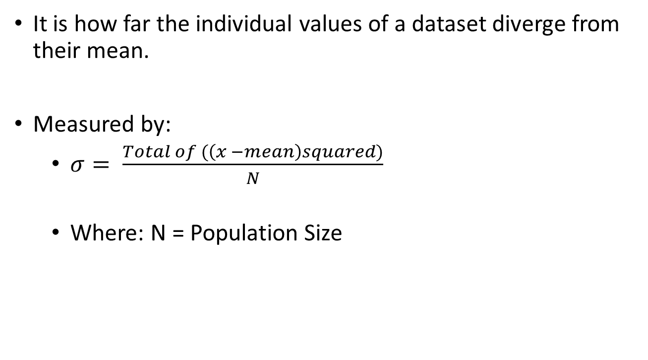
What is it?
It is how far the individual values of a dataset diverge from their mean.
Measured by:
$σ= \frac{Total of (\left(x −mean\right)squared)}{N}$
Where: N = Population Size

Slide 3
Note:
A distribution of Means follows a Normal Distribution while a distribution of Variance follows a Chi-Square distribution.

